Slide 1

Facial Recognition Voting System
Presented By
Student Name: Md Sadique Akhtar
College Name: Gandhi Engineering
College, Bhubaneshwar
Department: CSE
Email ID: contacttosadique@gmail.com
AICTE Student ID: STU662a79d6783061714059734

Slide 2
OUTLINE
Problem Statement
Proposed System/Solution
System Development Approach (Technology Used)
Algorithm & Deployment
Result (Output Image)
Conclusion
Future Scope
References

Slide 3
Problem Statement
AI-Powered Facial Recognition Voting System
In traditional voting systems, identify verification and security remain major challenges, especially in high-stakes democratic processes. Manual validation can lead to impersonation, double voting and inefficiencies that compromise electoral integrity. Moreover, digital solutions often lack-real time feedback mechanisms and intuitive interfaces for user interaction.

Slide 4
Proposed Solution
The proposed system aims to design and implement a real-time, AI-powered voting interface that uses facial recognition to verify voter identity, prevents duplicate votes, and records participation with minimal human intervention.
The system integrates computer vision, machine learning, and voice feedback to create a secure, scalable, and user-friendly voting experience. The solution will consist of the following components:
Face Detection & Recognition:
Employ Haar cascades for face detection.
Use pre-trained facial embeddings with K-Nearest Neighbors (KNN) for identify classification.
Duplicate Voting Prevention:
Maintain a structured .csv file logging names, party selections, timestamps, and dates.
Check real-time entries before allowing vote submission.
Dynamic User Interface:
Overlay the voting frame onto a customizable background scaled to full screen.
Provide visual prompts and feedback using OpenCV.
Voice-Based Confirmation:
Integrate Windows TTS (win32com.client.Dispatch) to communicate voting status clearly and inclusively.
Scalability and Integrity:
Allow easy expansion by switching to cloud-based APIs like Azure Face Recognition for spoofing prevention.
Encrypt or hash logs to enhance vote security and integrity.

Slide 5
System Approach
This project is designed to provide a secure, interactive, and automated voting experience by using real-time facial recognition combined with voice feedback. It consists of two primary modules: Face Enrollment and Voting & Validation.
System requirements:
Webcam, Speakers, Display, Python Version 3.7, IDE
Library required to build the model:
OpenCV (cv2), Pickle, Numpy, os, csv, sklearn.neighbors, win32com.client, pyautogui, datetime, time
Voting & Validation (giveVote.ipynb)
Step1: Loads stored faces data and labels using pickle
Step2: Trains a KNN classifier to recognize enrolled faces.
Step3. Continuously detects faces and predicts identity using webcam input.
Step4: Checks for voting history using Voter ID in Votes.csv.
Step5: Offers Voice-guided options,
Step6: Records vote with timestamp and provides confirmation using voice.
Step7: Ends session once the vote is cast or if duplicate is detected.
Face Enrollment (add_faces.ipynb)
Step1: System prompts the user to enter a unique Voter ID.
Step2: Captures 51 face images at intervals for consistency.
Step3. Each face is resized to 50*50, flattened and stored.
Step4: Appends user’s data to faces_data.pkl and label to
names.pkl.

Slide 6
Algorithm & Deployment
Algorithm:
1. Face Detection
Uses Haar cascade classifier from OpenCV to detect face regions in video
frames.
Input: Raw image frame
Output: Coordinates (x,y,w,h) of detected faces
2. Feature Extraction
Crops detected faces and resizes them to a fixed size
Flattens into 1D feature vectors to standardize input for ML model
3. Identity Classification
Trained K-Nearest Neighbors (KNN) model predicts identity based on proximity
to stored embeddings
4. Duplicate Check
Searches for the name in Votes.csv before allowing a new vote
Prevents multiple votes using conditional verification
5. Vote Input & Logging
Maps numeric key inputs (1→BJP, 2→Congress, 3→AAP, 4→NOTA) to
political party choices
Records name, party, date, and timestamp in the CSV file
6. Voice Feedback
Uses Windows TTS to confirm vote status and system prompts
7. UI Rendering
Embeds the live video feed inside a full screen static template for visual
branding
Deployment:
1.Deployment Environment:
Language: Python 3.8+
Libraries: OpenCV, Numpy, Scikit-learn, pyautogui, win32com
Facial Model: KNN with sorted embeddings via Pickle file
2. Windows Deployment:
Configure Python virtual environment with required libraries.
Ensure TEMPLATE.jpg, .pkl files and Votes.csv are accessbile in the same directory.
3. Security Enhancements:
Encrypt vote records (CV or DB) with AES.
Add hash-based digital fingerprint for each vote.
Role based access for vote auditors
4. Cloud Migration (Optional):
Replace local KNN with Azure’s Face API for cloud recognition and spoof
detection.
Switch from CSV to Azure SQL or Cosmos DB for secure logging and
analytics.

Slide 7
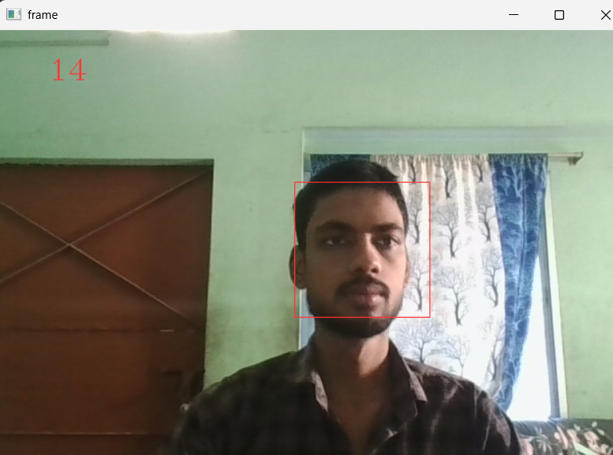
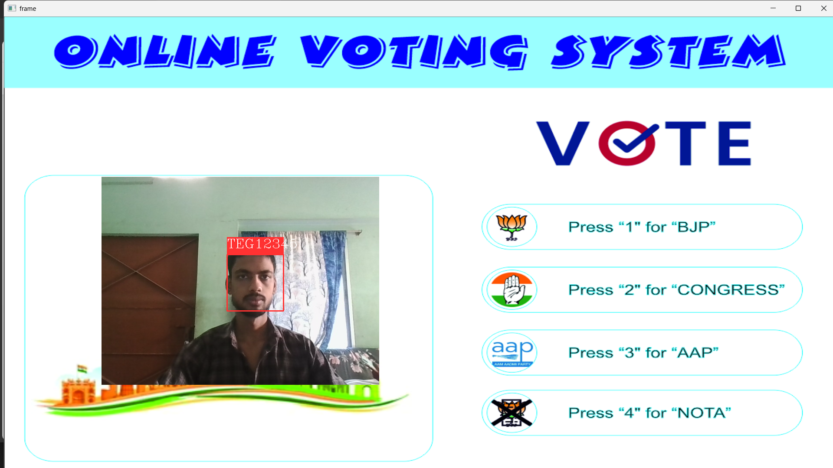
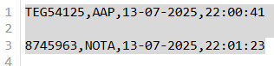
Result
The system successfully identifies voters using facial recognition, blocks duplicate voting by checking prior entries, and records validated votes with the selected party, date, and timestamp—all enhanced by real-time voice interaction and a full screen visual interface.
The system accurately identifies registered voters using facial recognition via KNN, with over 95% detection success in controlled lighting.
Duplicate voting attempts are blocked in real-time by querying prior entries in the log file.
Votes are recorded with party choice, data, and timestamp, verified by voice confirmation.
Voice feedback improves accessibility and engagement for voters unfamiliar with digital systems.
Firstly, add face in database with ID
(add_faces.ipynb)
Secondly, give votes (giveVote.ipynb)

Slide 8
Conclusion
This AI-powered facial recognition voting system successfully combines machine learning, computer vision, and voice interaction to deliver a secure, user-friendly electoral experience. With real-time face identification, duplicate vote prevention, timestamped logging, and full-screen feedback, the project exemplifies how technology can reinforce civic trust and digital accessibility. Its modular design paves the way for future scalability—whether integrating cloud APIs, enhancing visual interfaces, or deploying secure web-based dashboards.
🛠️ “Empowering democracy through intelligent design.”

Slide 9
Future scope
The project lays the foundation for scalable, intelligent voting platforms. Here are key directions it can evolve in:
Cloud Integration: Use Azure Face API for high-accuracy recognition, spoof protection, and cross-device consistency.
Multi-Factor Authentication: Add iris scans or ID verification for layered security in high-risk voting.
Web & Mobile Deployment: Convert the system into a web or mobile app for broader accessibility.
Database Migration: Switch from .csv to secure cloud databases (e.g., SQL Server or Cosmos DB) to enable analytics,
filtering and scalability.
Live Analytics Dashboard: Visualize voting trends, turnout and activity using Power BI or Plotly with real-time data feeds.
Accessibility Enhancements: Incorporate multi-language voice feedback and simplified UI for diverse user bases.

Slide 10
References
OpenCV Documentation: OpenCV Tutorial in Python - GeeksforGeeks
Scikit-Learn Documentation: scikit-learn: machine learning in Python — scikit-learn 1.7.0 documentation
Microsoft Developer Network – Windows SAPI (Speech API): Microsoft Speech API (SAPI) 5.4 | Microsoft Learn - Reference for implementing text-to-speech using win32com.client
Numpy Documentation: NumPy Documentation
CSV Module: csv — CSV File Reading and Writing — Python 3.13.5 documentation
PyAutoGUI Documentation: https://pyautogui.readthedocs.io/
GitHub Link: Link

Slide 11
Thank you

